Slide 1
NJROTC NS-4 Leadership and Ethics

Slide 2
Lesson 04.01 Relationships and Attitude

Slide 3
Explain why the power of positive relationships and attitude are important in becoming an effective leader.
Lesson Goal

Slide 4
Learning Objectives
State the two components of leading by example.
Explain the influence that the relationship between officers and their peers has on everyone’s performance.
State the characteristics of effective and successful officers.

Slide 5
Learning Objectives
Explain the influence that attitude has on everyone’s performance.
Identify the ways in which a leader can lose the respect of subordinates.
Define the key term service reputation.

Slide 6
Have you ever known a successful leader who didn't set a good example?
Yes
No
(NS4-U4L1:LQ1)

Slide 7
Discussion
How much of a difference does having a good relationship with a leader make?
Can a leader be successful without a good relationship with subordinates?
Have you ever had the opportunity to be led by someone with a reliably good attitude?
If so, did their good cheer affect your performance?

Slide 8
Introduction
Naval officers are known by their service reputation – the unwritten, unspoken, unlisted net assessment of an officer’s pluses and minuses.
Officers know that their behavior and attitude affect people they work with and form the basis of their service reputation.

Slide 9
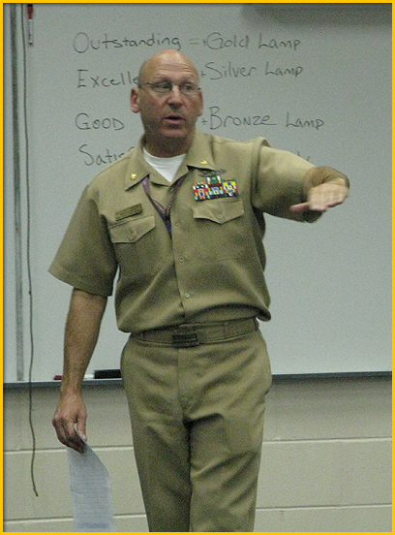
Practical Advice for Leading by Example
ADM Kazuomi Uchida:
“An officer’s behavior considerably influences other individuals.”
“He must be always unselfish and fair to subordinates.”
“An officer’s humanity is perceived through his behavior.”

Slide 10
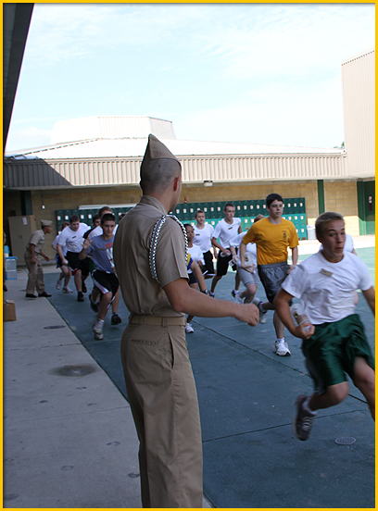
The Power of Positive Relationships
The relationship between officers and their people has an effect on everyone’s performance.
When crew members complain proudly about their hardships, they likely have a good relationship with their commander.

Slide 11
Camaraderie with Discipline
Officers don’t sacrifice discipline for camaraderie.
An officer can develop camaraderie without losing discipline.

Slide 12
Camaraderie with Discipline
ADM Elmo Zumwalt:
Commanded the world’s first guided missile frigate, the USS Dewey.
Allowed his department heads to discuss in “very vigorous terms” their suggestions for changes.
Knew that “when the chips were down … there was instant and total obedience.”

Slide 13
CNO Jonathan Greenert
Select Video to Start or Pause

Slide 14
Officers can develop good relationships with subordinates that include camaraderie and discipline.
True
False
(NS4-U4L1:LQ2)

Slide 15
Effective and Successful Officers
ADM Zumwalt on characteristics of a good officer:
Belief that the Navy is worthwhile
Pride in service
Dedication to the mission of the Navy and to the concept of the life of service

Slide 16
Effective and Successful Officers
ADM Zumwalt:
An officer isn’t required to see the Navy as “something sacred and unchangeable.”
Rather, he can “be positively critical of those areas that need fixing.”

Slide 17
Effective and Successful Officers
ADM Zumwalt:
Officers should be good citizens of the unit.
If there are personality clashes, it is the officer’s responsibility to understand the other person’s perspective.
Officers should look for practical compromises.

Slide 18
The Power of a Positive Attitude
Having a positive attitude can impact the effectiveness of your unit.
Subordinates follow your lead, including your attitude.
In debriefings, critique in a constructive way while accentuating the positives.

Slide 19
The Power of a Positive Attitude
Dwelling on negatives helps no one.
If you are naturally timid or pessimistic, overcome your nature through training exercises.
Remember, there is a big difference between failure due to physical inability and failure due to lack of motivation.

Slide 20
Officers can strengthen their units through _______.
willingness to compromise
keeping a positive attitude
positive and constructive criticism
All of the above
1
1
1
1
(NS4-U4L1:LQ3)

Slide 21
Setting the Example

Slide 22
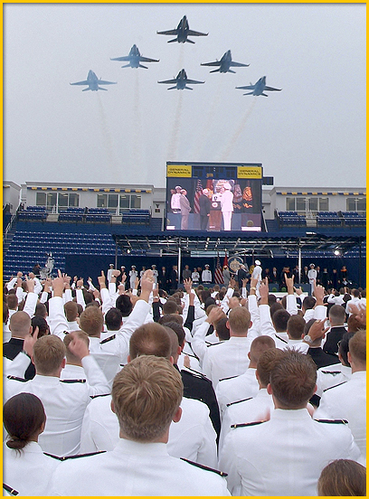
Setting the Example
ADM Thomas Hayward:
“The crew has a right to look upon their leader with respect.”
“But the leader has to earn their respect and work to keep it.”

Slide 23
Setting the Example
ADM Thomas Hayward:
“The quickest way to lose respect is to set a bad example.”
“This includes doing the kinds of things that some may think are macho or funny, but that in the long run are going to undermine the morale.”

Slide 24
ADM Gary Roughead
Select Video to Start or Pause

Slide 25
Behavior is a basic element of setting the example.
True
False
(NS4-U4L1:LQ4)

Slide 26
Lesson Summary
In this lesson you have:
Explained why the power of positive relationships and attitude are important in becoming an effective leader.
Stated the two components of leading by example.
Explained the influence that the relationship between officers and their peers has on everyone’s performance.

Slide 27
Lesson Summary
In this lesson you have:
Stated the characteristics of effective and successful officers.
Explained the influence that attitude has on everyone’s performance.
Identified the ways in which a leader can lose the respect of subordinates.
Defined the key term service reputation.

Slide 28
Leaderboard
Last
Slide
Points | Participant | Points | Participant

Slide 29
Whiteboard
Last
Slide

